Slide 1
Analysis of MIMIC Microbiology Data
AI in Healthcare (AI 395T)
Jef DeWitt - February 5, 2025

Slide 2
These queries build a comprehensive infection analysis, starting with who gets infected first.
Then, the study moves into patterns and resistance trends.
Finally, mortality and seasonal cycles are discovered.
The focus is on relevant insights—whether it's targeting high-risk patients, improving antibiotic policies, or enhancing infection control procedures.

Slide 3
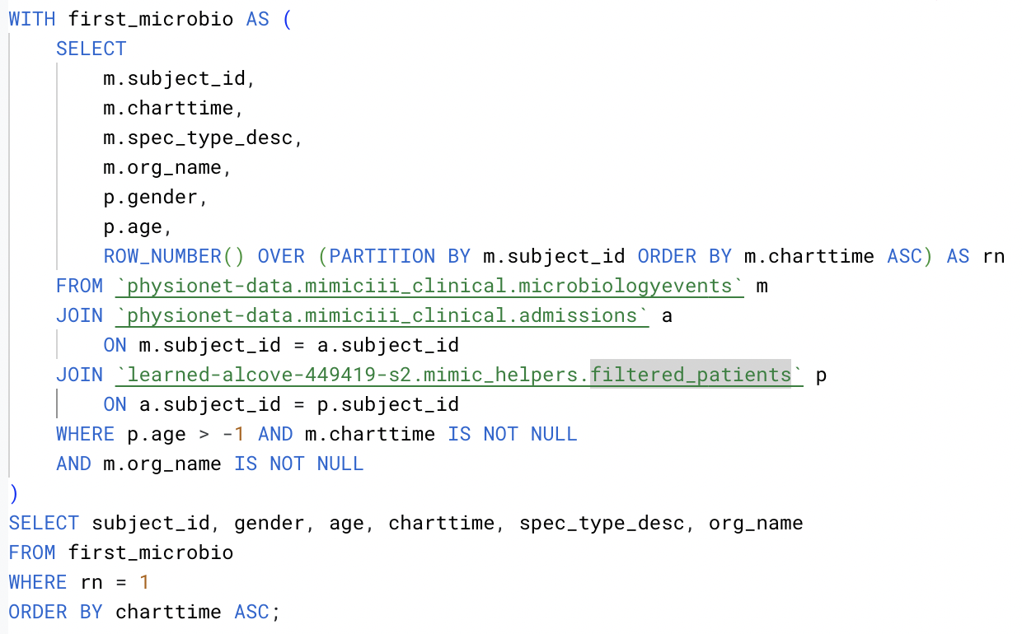
#1 Identifying Who is at Risk
Query
This query links patient info to their earliest infection.
A subquery with ROW_NUMBER() prevents duplicate results by ranking patient records (via charttime). PARTITION BY m.subject_id ensures we only keep one row per patient. Microbiologyevents is joined with admissions and filtered patients (a custom table used to store patients < 120 years old), providing patient, infection, and admission information.
The first patient record is selected from the temporary view, first_microbio. The first row number (rn) is the first patient record, according to charttime.

Slide 4
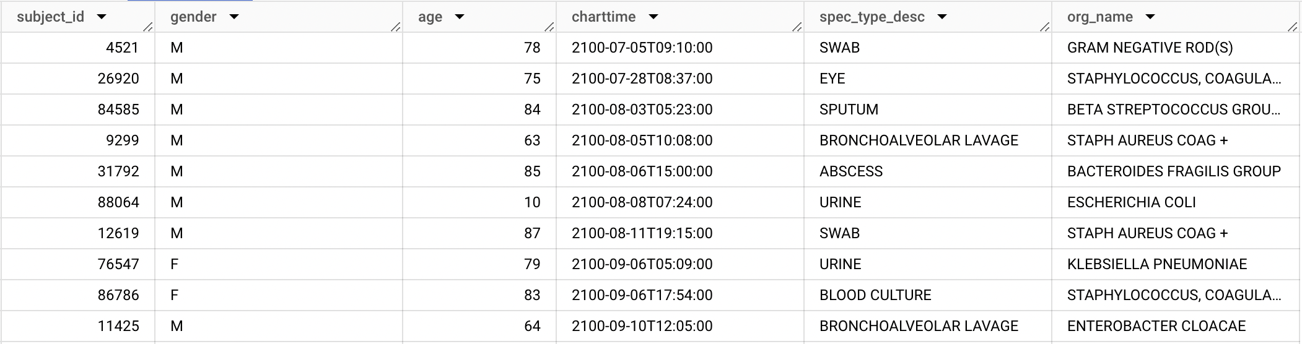
#1 Identifying Who is at Risk
Results
Aim: Reveal patterns amid patient, admission, and microbiology events information.
This query establishes a connection between patients and their earliest microbiology exams. Understanding age, gender, and infection trends helps at-risk populations.

Slide 5
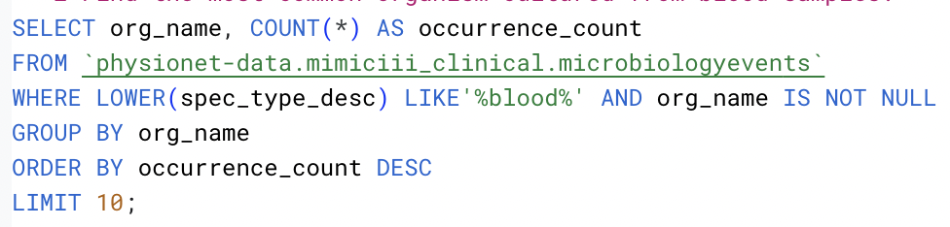
#2 Microorganism Distribution
Query
Find the most common organism cultured from blood samples.
Count occurrences of organisms in microbiology events records as occurrence count.
Normalize specimen types for pattern matching and remove null values.
GROUP BY org_name to sort occurrences according to volume.

Slide 6
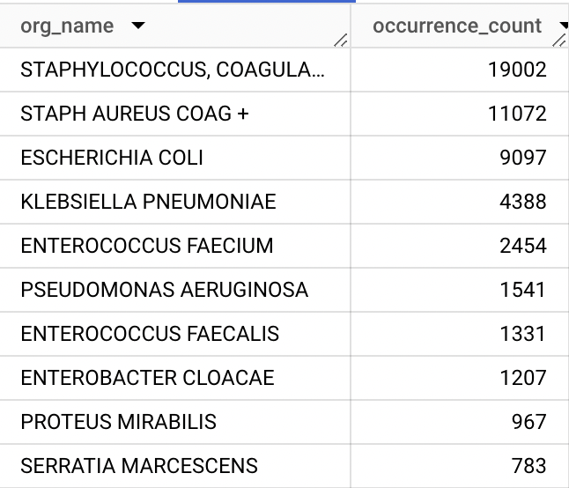
#2 Microorganism Distribution
Results
Aim: Identify the most frequently occurring infections, highlighting dominant bloodstream pathogens.
Frequent pathogens can indicate hospital-acquired infections or community transmission trends.

Slide 7
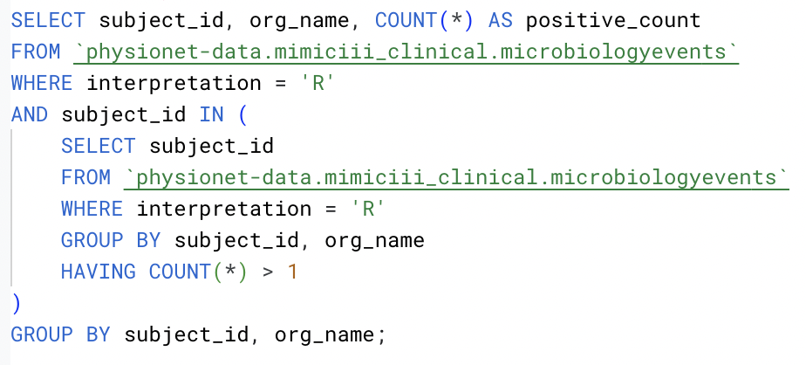
#3 Multiple Positive Tests
Query
Query patients who tested positive for the same pathogen more than once.
GROUP BY subject_id and org_name, ensuring that only patients with multiple positive results for the same microorganisms are counted, using HAVING COUNT(*) > 1.
Filter out interpretations less severe than resistant (R). Count the resistant occurrences and return them along with the organism and patient.

Slide 8
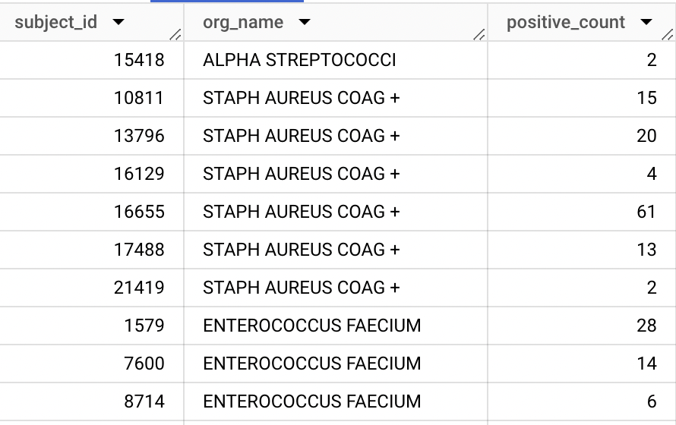
#3 Multiple Positive Tests
Results
Aim: Recurrent infections may signal treatment failure or worse.
This study helps identify patients who need additional or alternative therapies.

Slide 9
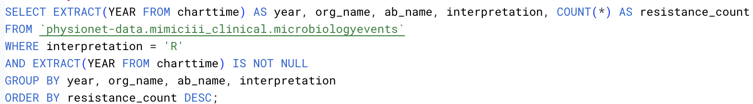
#4 Antibiotic Resistance Over Time
Query
Group data by organisms, antibiotic treatments, year, and severity.
Filter out interpretations less severe than resistant (R).
Extract the year from charttimes and disregard records that don’t yield a year value.
Order by number of occurrences.

Slide 10
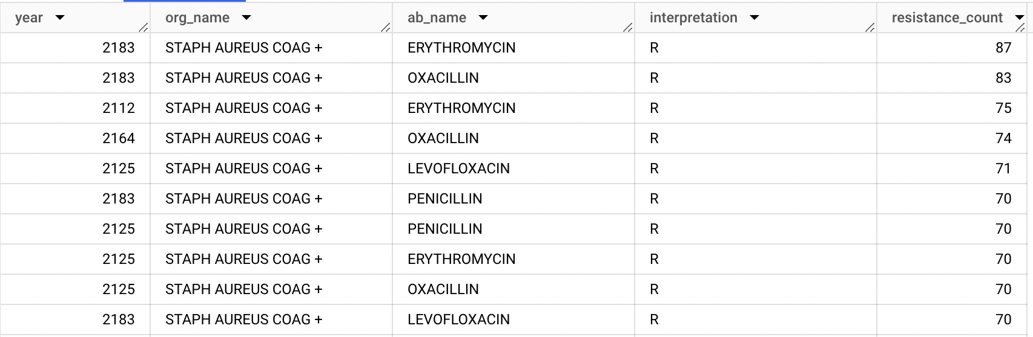
#4 Antibiotic Resistance Over Time
Results
Aim: Determine which bacteria strains are becoming more resistant over time, and which antibiotics are most impacted.
The real-world application of this information could lead to understanding the evolving dominance and treatment options for certain bacteria.

Slide 11
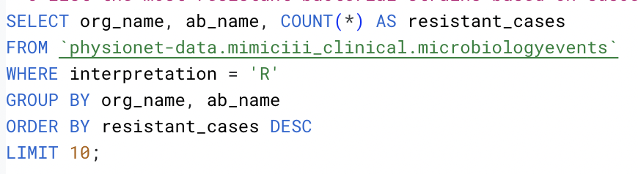
#5 Most Resistant Bacteria
Query
Here is a count of the most treatment-resistant microbes.
WHERE interpretation = ‘R' keeps only the cases where the bacteria showed resistance.
Sort results by occurrence frequency.
Limit results for increased emphasis on the highest priority bacteria.

Slide 12
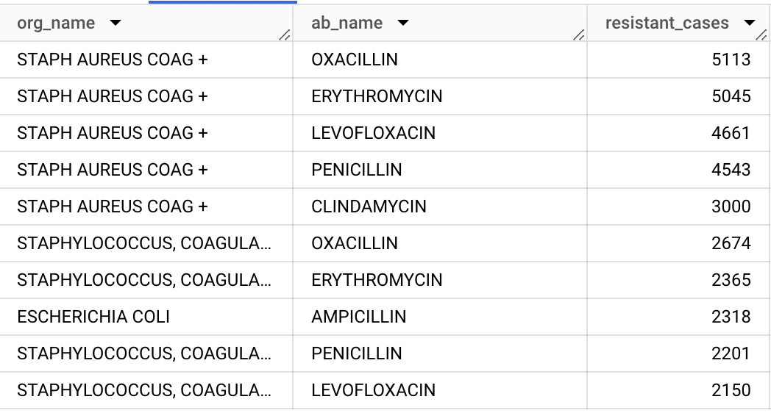
#5 Most Resistant Bacteria
Results
Aim: Identify which bacteria are the most resistant to antibiotics.
This could guide hospital infection prevention policies and alternative treatment development; leading to better antibiotic stewardship.

Slide 13
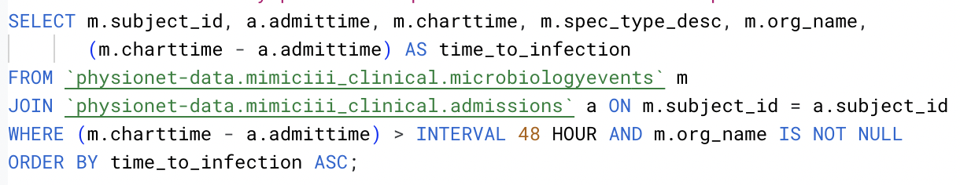
#6 Infection After Admission
Query
Joining microbiologyevents and admissions tables allows access to both admission and infection time data.
Comparing admission time (admittime) to first infection time (charttime) reveals the length of time until detection (time_to_infection).
Intervals (time to detection) longer than 48 hours of admission are considered likely acquired in-hospital.
Filter empty organism names from results and return based on time_to_infection.

Slide 14
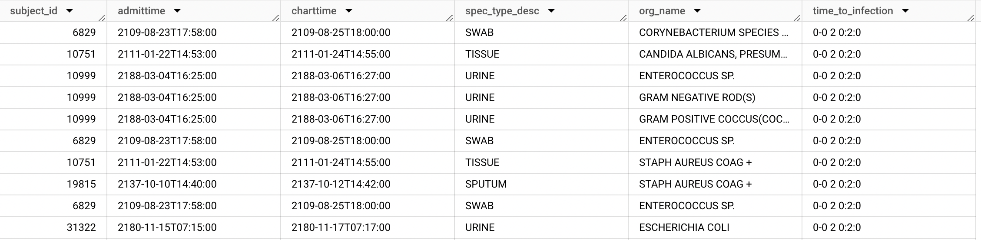
#6 Infection After Admission
Results
Aim: Differentiate between infections acquired inside and outside of hospitals
Hospital-acquired infections (HAIs) increase hospital costs, patient mortality, and length of stay.

Slide 15
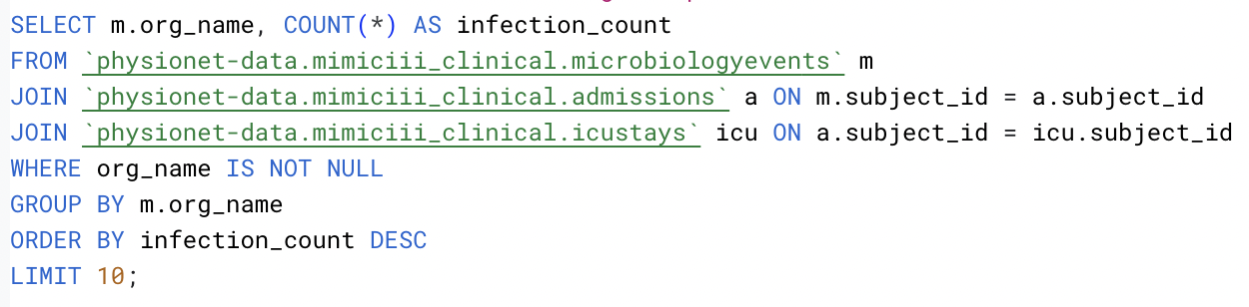
#7 Common ICU Infections
Query
Here is a query structured to focus specifically on ICU admissions.
Join icustays with patients and microbiologyevents tables, by way of shared subject_id fields.
Count occurrences of m.org_name (organism name) and label as infection_count.
Group results around organism name (not null) and organize by highest infection_count.

Slide 16
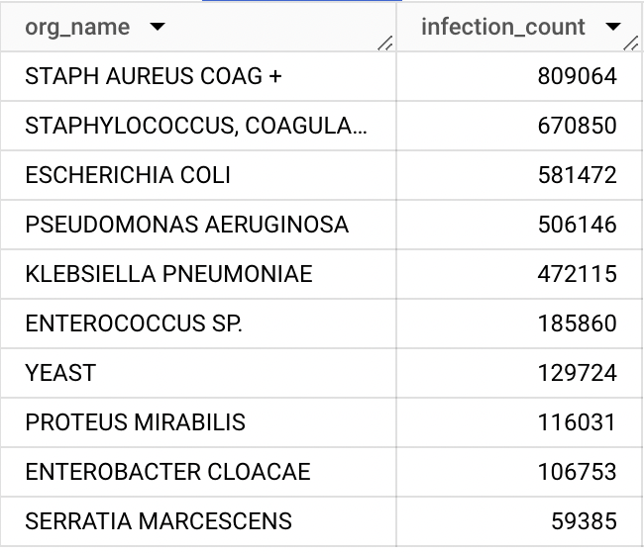
#7 Common ICU Infections
Results
Aim: Identify the most frequent infections.
Reveal common pathogens in critically ill patients.

Slide 17
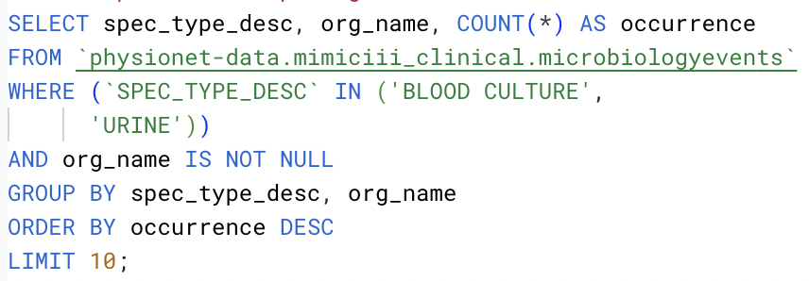
#8 Blood Versus Urine Pathogens
Query
This query was designed to compare pathogens found in blood vs. urine samples.
Using GROUP BY spec_type_desc and org_name, a side-by-side comparison of bloodstream and urine infections is created.
Filter out null org_name values and return the highest occurring results.

Slide 18
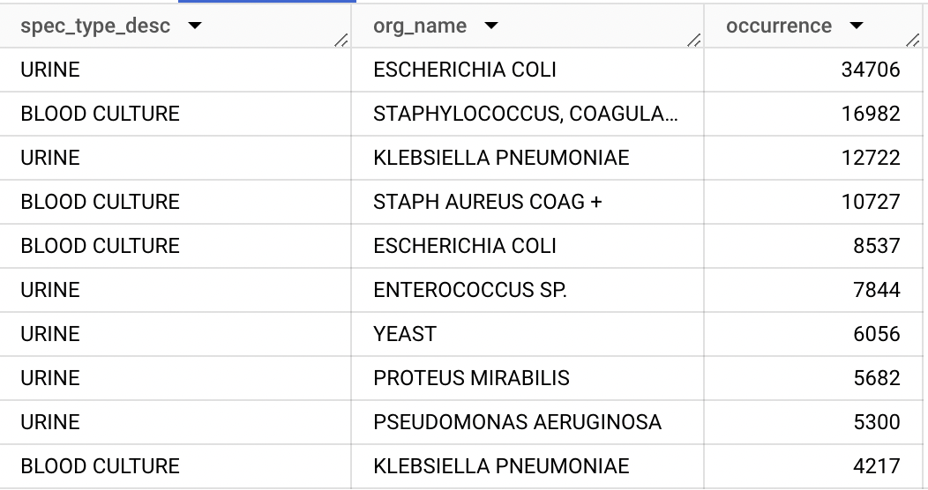
#8 Blood Versus Urine Pathogens
Results
Aim: Highlight the different pathogens commonly found in blood vs. urine samples.
This might refine antibiotic selection and improve early treatment effectiveness based on site-specific patterns.

Slide 19
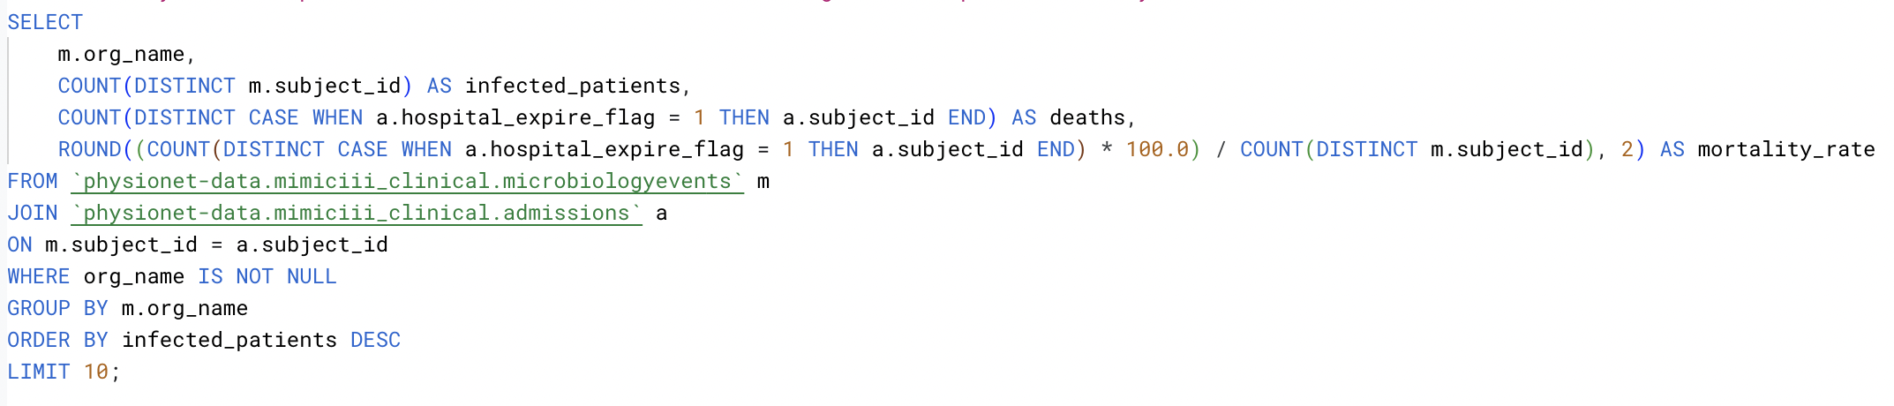
#9 Infection & Mortality
Query
Calculate mortality rate using hospital_expire_flag.
Count hospital deaths from a specific organism and divide by the number of unique patients infected with said organism. Round the percentage to the nearest integer.
Group by organism, filtering out nulls, and order the results based on the number of infected patients.

Slide 20
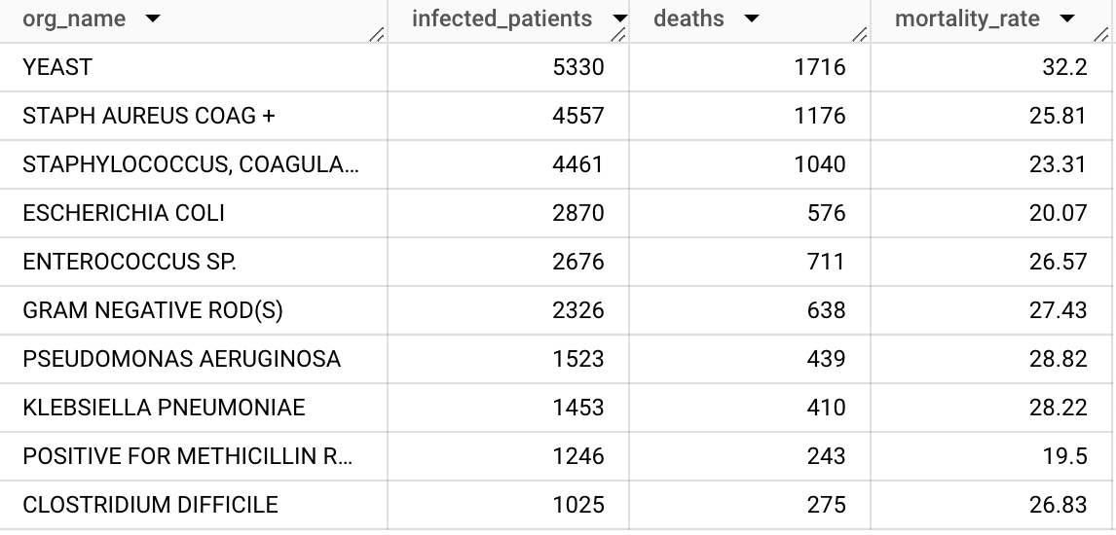
#9 Infection & Mortality
Results
Aim: Identify infections with the highest fatality rates.
This shows which infections require aggressive, early intervention; which could lead to enhanced survival rates.

Slide 21
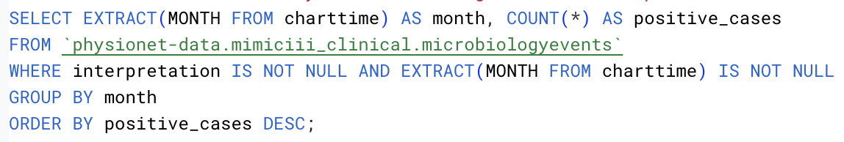
#10 Seasonal Microbiology
Query
Extracting the month from charttime allows the grouping of microbiology events as postive_cases.
These cases are then filtered by interpretation, removing any nulls for that feature, as well as the months calculated from charttime.
Group according to month and order by the number of positive cases.

Slide 22
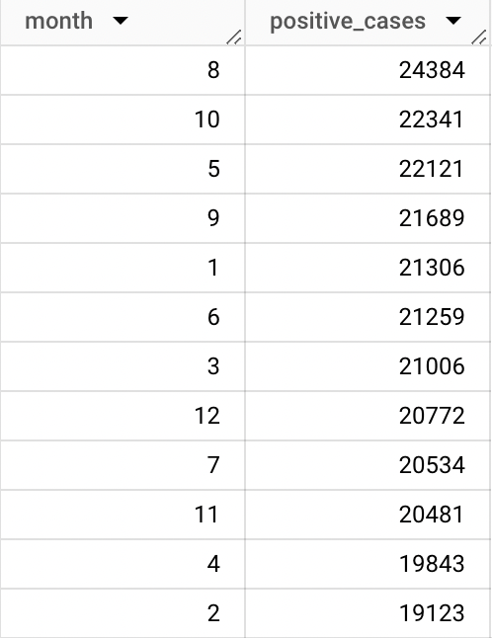
#10 Seasonal Microbiology
Results
Aim: Identify seasonal surges in infections (e.g., flu season, summer UTI spikes), allowing better resource allocation.
Based on this insight, hospitals can adjust staffing, supplies, and infection control measures based on seasonal trends.

Slide 23
Thank you for your time!

